Slide 1
Alpine Pearls
A Network Promoting Environmentally Friendly Holidays
Dagmar Lund-Durlacher, Anja Hergesell, Karmen Mentil

Slide 2
Learning Outcomes
After completing this case study, learners should be able to:
understand the role of sustainable transportation in the provision of the tourism product;
identify stakeholders and their role in delivering a sustainable tourist experience;
analyse opportunities and challenges, and develop strategies to involve stakeholders for sustainable tourism development;
recognise challenges and barriers to successful stakeholder management; and
explain the role of communication in successful stakeholder management.

Slide 3
Background
Winner of the 2011 WTTC Tourism For Tomorrow Awards in “Destination Stewardship”
International network with 28 members in 6 countries of the European Alps
Established on 29 January 2006 with 17 founding members
Aim: promoting and encouraging the development of environmentally friendly holiday offers with particular focus on environmentally friendly transport and fun mobility solutions

Slide 4
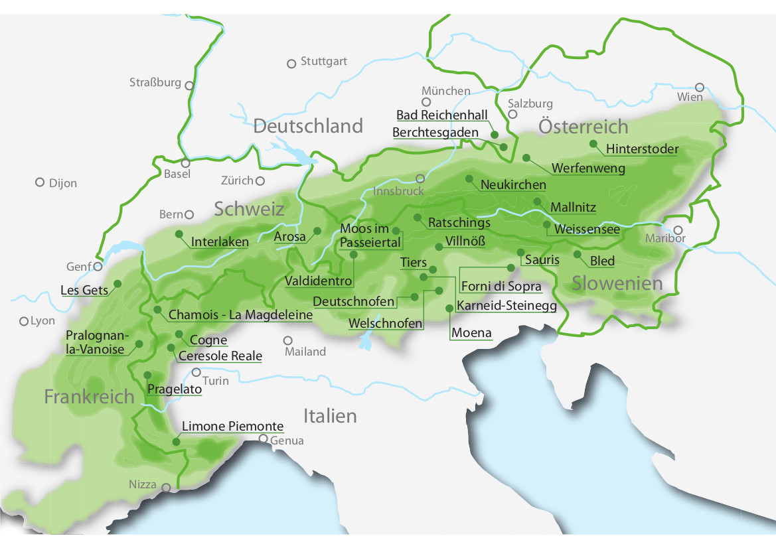
Member Destinations

Slide 5
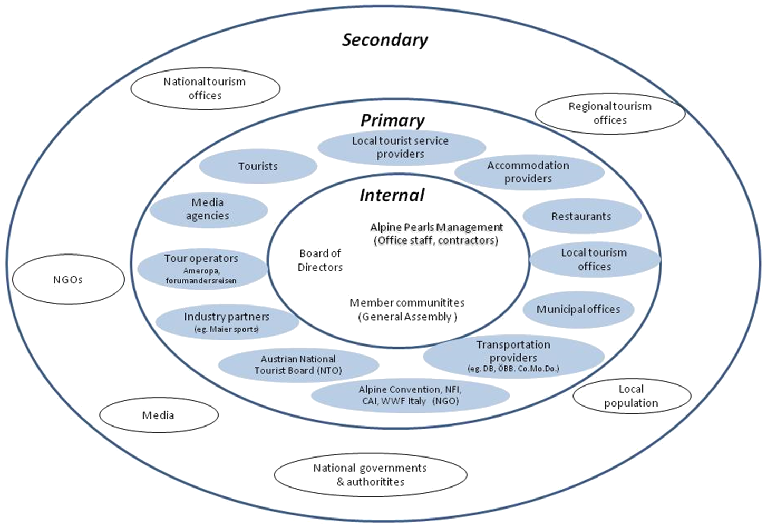
Alpine Pearls Stakeholders

Slide 6
Arrivals & Overnights

Slide 7
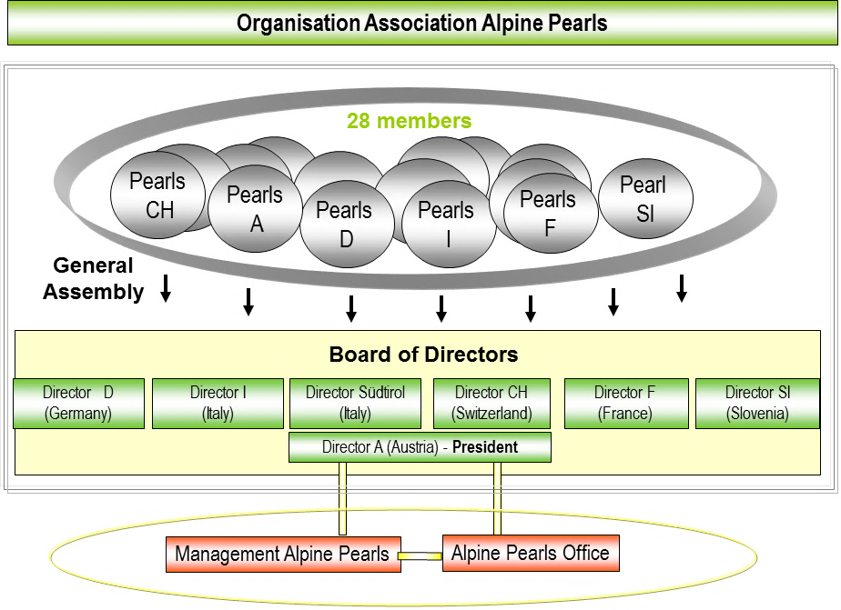
Organisational Chart

Slide 8
Study Questions
Visit the website http://www.alpine-pearls.com/en/holiday-offers.html, choose 2-3 of the holiday packages on offer by clicking on the respective photo and discuss their environmental friendliness considering the mobility aspects discussed in the case study and drawing on the criteria listed in the appendix.
Identify the stakeholders of Alpine Pearls (internal and external) and describe their role in producing/delivering the tourist product/tourist experience.
How does Alpine Pearls involve stakeholders for sustainable tourism development in their member destinations? What problems could be encountered in this process? Consider differences in size, geographic spread and type of membership.
Describe the communication between the stakeholders (intern, external). What are the challenges to effective communication?
Discuss the challenges encountered by Alpine Pearls and its internal stakeholders. Form groups and develop ideas of how to address these challenges.

