Slide 1
Ionian Eco Villagers, Nature World Travel and Earth, Sea & Sky
A collaborative approach to sustainability in tourism
Marianna Sigala

Slide 2
Learning Outcomes
After completing this case study learners should be able to demonstrate:
the importance of managing sustainability from a tourism supply chain perspective;
the need to develop and nurture a stakeholder network for developing and implementing collaborative sustainable practices that create shared (economic, social and environmental) value to all stakeholders;
the importance of tourist roles and behaviour in achieving and supporting tourism sustainability; and
the affordances of social media to enrich, expand and nurture the sustainable collaborative practices of organisations as well as to further empower customers to actively get involved in sustainability.

Slide 3
Vertically Integrated Organisations
Three Organisations
Ionian Eco Villagers: eco-friendly accommodation
Nature World Travel: a sustainable tour operator
Earth, Sea & Sky: a NGO focusing on the protection of marine life
The key success factor and distinctive advantage of the organisation relies on its capabilities:
to design and control the provision of a holistic sustainable tourism experience covering almost all tourism services (accommodation, activities, excursions, education); and
to influence and direct the behaviour of numerous stakeholders (tourists, locals, volunteers, professionals, governments) towards a sustainable code of conduct that creates win-win situations and benefits everyone.

Slide 4
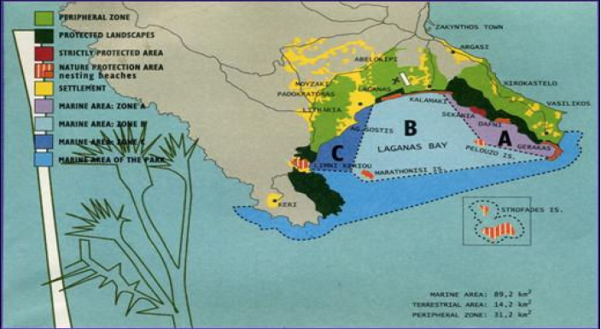
Location of the Organisations
The Marine National Park of Zakynthos
Notes:
4

Slide 5
Collaboration
The organisations create shared value for all stakeholders by adopting the following models:
The creation of market 'ecosystems' that enable organisations to collaborate and build partnerships with many stakeholders (NGOs, governments, activists groups, citizens, suppliers etc.) in order to have a greater, holistic and sustainable social impact.
The expansion of value chains in order to enable organisations to support sustainability not only by managing internal operations, but also by influencing the business processes that go beyond their organisational borders and are affected by third party organisations such as suppliers, partners and governments. Many businesses currently implement and manage sustainability from a Supply Chain Management (SCM) approach that considers the activities of all organisations in their business network.
The creation of new industrial clusters or networks whereby multi-stakeholder collaborative and easily controllable sustainable practices can be developed.

Slide 6
SCM process | Sustainability goals | Examples of sustainable practices
Sustainable Product Design | Design and creation of a sustainable tourism product, e.g.: Inclusion and selection only of sustainable suppliers Design of tourist activities at destinations that aim to educate tourists and influence their behaviour towards the protection of environmental resources | Supporting local accommodation providers to design and provide environmental friendly accommodation products, e.g. solar heating, energy saving bulbs, no swimming pools Use of eco-friendly catamaran cruises Nature walks for educating and informing tourists about the local fauna and flora
Sustainable Procurement | Development of tour packages that include sustainable tourism services/products: to achieve that the firm needs to carefully select the various suppliers and stakeholders (e.g. tour guides, public authorities) with which it will cooperate to develop the tour package | Use of local accommodation providers Protection and conservation of local culture and nature Free hire of bicycles to explore the island
Sustainable Production | Tourism consumption takes places at the destination whereby many stakeholders are involved: Sustainable management of tourism destinations Sustainable management of the organisations’ internal processes (e.g. tour operator business, accommodation, transportation, tour guides etc.) Sustainable management (e.g. awareness – education) of tourists | Use of volunteers in excursions for informing and controlling tourists’ behaviour Volunteers cleaning up beaches Minimum printing (e.g. brochures, electronic communication and transactions ) and minimum use of energy Free hire of beach umbrellas, beach towels and inflatable beds (eliminating the purchase and throwing away of these items)
Sustainable delivery – distribution | The use and management of a tourism distribution system and intermediaries that support sustainability, e.g. retail networks, travel agents and tour operators | Mr Vardakastanis created a new company Green Tree Transfers www.greentreetransfers.com, which specialises in sustainable distribution and logistics services by offering private airport transfers and car hire. For every single leg of a transfer or taxi trip booked through Green Transfers, the organisation plants a tree on Zakynthos. NWT is a sustainable focused tour operator, that focuses on the design, distribution and promotion of sustainable holiday packages and experiences in Zakynthos. When traveling to Zakynthos, NWT offers travellers carbon off-setting purchase options for trading off their carbon emissions
Sustainable Reverse logistics | Measuring sustainability performance and usage of feedback mechanisms for monitoring and tracking performance and enabling learning and continuous improvement Tourists and volunteers are encouraged to adopt a sustainable lifestyle after their visit on Zakynthos | The organisation monitors and measure annual sustainability performance. Annual Assessment Reports are produced and disseminated in order to inform and motivate further action as well as create wider awareness and sensitivity towards sustainability The organisations exploit social media for: engaging and motivating tourists and volunteers to share their experiences on Zakynthos with others; promoting and disseminating sustainability concerns; and creating and participating in virtual communities that aim to support collaborative sustainable practices.
Source: adapted from Sigala (2008)

Slide 7
Collaborative Network of ESS
Friends of the Ionian www.foi.org.uk | Sustainable tourism organisation working on all Ionian islands
Earth In Focus www.earthinfocus.com | A showcase for three up-and-coming photographers who all have a love of photography, travel and conservation.
Medasset www.medasset.gr | Greek conservation group working to protect sea turtles
Sea Turtles www.seaturtle.org | Track the progress of turtles fitted with radio tracking devices
Justzante www.justzante.co.uk | All you need to know about Zakynthos; user news & reviews
The NMPZ www.nmp-zak.org | The National marine Park of Zakynthos
Archelon www.archelon.gr | Greek sea turtle conservation organisation that Nature World Travel and Earth Sea & Sky support at Gerakas
Euroturtle www.euroturtle.org | Educational turtle website

Slide 8
Exploiting Social Media
www.thepetitionsite.com/2/the-illegal-hunting-of-migratory-birds-on-zakynthos-greece | A petition website used by ESS in order to initiate and disseminate an online petition against illegal hunting of migratory birds
http://www.facebook.com/pages/Earth-Sea-Sky-Ionian-Nature-Conservation/120087021389714 | The Facebook profile and community of the three organisations
http://www.youtube.com/user/EARTHSEASKYorg | The youtube channel of ESS for disseminating videos about their activities for raising awareness and educating the public
http://earth-sea-sky-global.org/about-us | The blog of ESS used as a daily newsletter for supporting international public awareness and information
http://www.goabroad.com/providers/earth-sea-sky/programs/sea-turtle-and-wildlife-research-in-greece-55480 | GoAbroad.com is a leading international education and experiential travel resource. GoAbroad is also a worldwide volunteer network. ESS has used this network in order to initiate an international campaign for recruiting volunteers.

Slide 9
Study Questions
Debate and give examples of why the creation of a collaborative network is important for achieving and supporting sustainability in tourism.
What practices have IEV, NWT and ESS developed for supporting sustainable tourism and creating shared value? Which stakeholders have they engaged with? What social benefits/value (economic, social and environmental) does each stakeholder get and what does each contribute through these collaborative activities?
Provide examples of how Mr Vardakastanis can exploit the power of crowdfunding for raising funds to support the conservation activities of his organisations. For example, how can websites such as www.spot.us, www.kickstarter.com/ and www.indiegogo.com/ be utilised?

Slide 10
Study Questions
Prepare a report analysing how Mr Vardakastanis can exploit social media for supporting the operations of his organisations (e.g. volunteer recruitment, sustainable promotion, raising environmental awareness and education). Your report should include the use of social media internally (i.e. how the organisation can develop and use its own social media tools, e.g. a blog) and externally (i.e. how the organisation can exploit existing social media such as Facebook). To better develop this report, investigate how the following organisations use social media: http://www.wwf.org/; http://www.conservation.org/; http://www.joinred.com/; www.oneplanetliving.org.
What advice would you give to Mr Vardakastanis to address the locals’ persistence and priority towards short-term profit during this period of the economic crisis?

