Slide 1
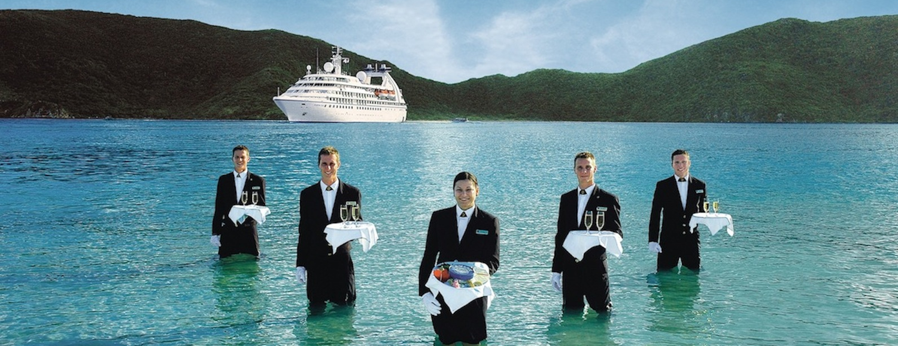

© Hudson & Hudson. Customer Service for Hospitality & Tourism

Slide 2
Topics Covered
Customer service defined
A history of customer service
The role of customer service
  Unique characteristics of services
  Services marketing triangle
  The services marketing mix
Customer service in the tourism and hospitality sector

Slide 3
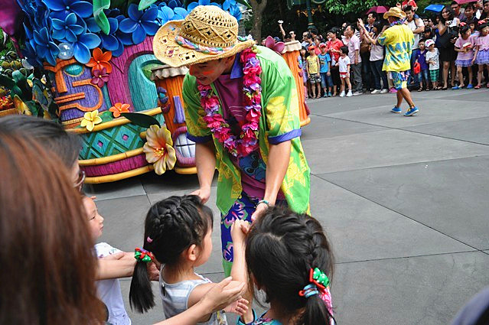
‘At Your Service Spotlight’: Walt Disney – a legacy of customer service
Disneyland is a work of love. We didn’t go into Disneyland just with the idea of making money’.
Walt’s personal philosophy (values, morals, religious beliefs, creative goals, innate psychographic awareness)
Excellence more crucial than profits
Disney’s commitment to its customers - focus on the guest experience rather than traditional business efficiencies
‘Imagineering’
  ‘what ifs’
  positive alternative to saying ‘no’
‘Guestology’
  novel approach to staff training
  internal language
  ‘wow’ moments

Slide 4
Customer service
…the practice of delivering products and services to both internal and external customers via the efforts of employees or through the provision of an appropriate servicescape.
Services and service culture
Interaction between employees and customers
Physical infrastructure

Slide 5
History of customer service
1800s Craftsman economy
  Business owners also frontline employees
  Customized orders
20th century mass production
  Less individualized service
  Post WWII demand: Power of suppliers surpasses that of consumers
  1970s: Western manufacturers compete with Asia
  1990sL Suppliers more selective
Present day: Shift to service economy

Slide 6
Why the decline in customer service?
Companies wrongly believe they are providing service excellence
Organizations don’t understand the significance of customer service
Companies don’t know how to deliver consistent, high quality customer service on an on-going basis

Slide 7
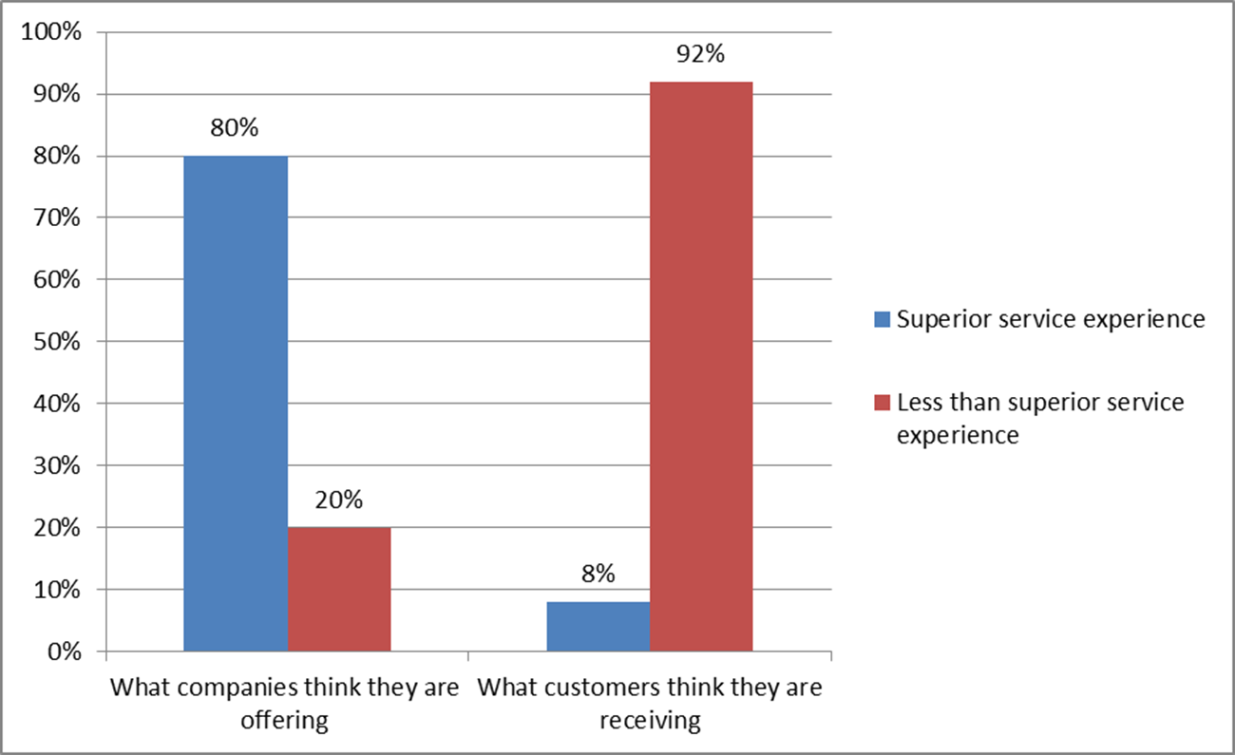
The customer service perception gap

Slide 8
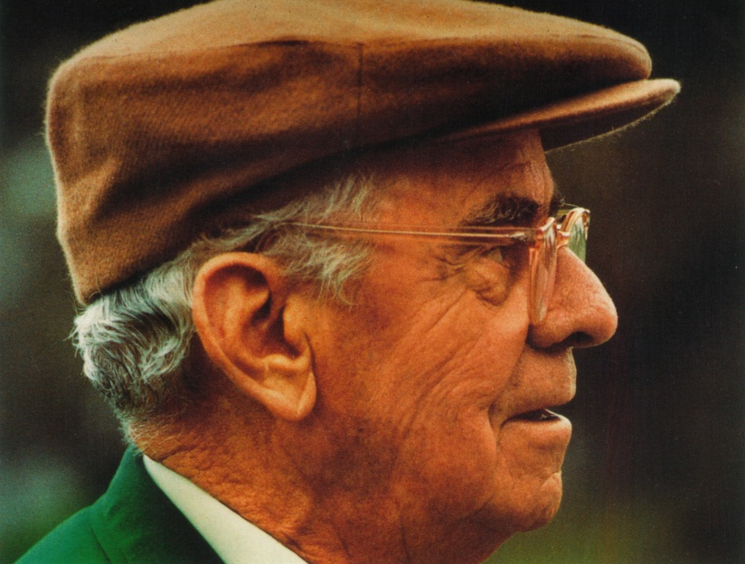
Snapshot: Customer service at the Augusta Masters
‘In the race for excellence, there is no finishing line’.
Many key features of professional golf tournaments introduced in Augusta
Patrons
  Sight lines, bleachers, observation stands, closed circuit TV
  Lunch food, refreshment stands
  Picnicking grounds, plenty of lavatories
  Tournament played over four days
Media
  First tournament on nationwide radio
  Cups, bags ‘invisible’ to cameras
  On-course scoreboard network
  Roped galleries

Slide 9
Role of customer service
Models to assist in services marketing and management decisions at the strategic and implementation levels:
Four unique characteristics of services
The services marketing triangle
The marketing mix for services

Slide 10
Unique characteristics of services

Slide 11
The services marketing triangle

Slide 12
Expanded Marketing Mix for Services

Slide 13
Additional 3 ‘P’s of Services Marketing

Slide 14
Tourism and hospitality market
….activities of persons travelling to and staying in places outside their usual environment for not more than one consecutive year for leisure, business and other purposes not related to the exercise of an activity remunerated from within the place visited (UNWTO)
Demand for a wide range of travel and hospitality products
Total market now serviced by the world’s largest industry
    International arrivals: 50 million in 1950 to 935 million in 2010 (UNWTO, 2011).

Slide 15
Western markets
Mature hospitality and tourism markets
  Severe competition
  Low product differentiation
  Limited promotional cost
  Customer service increasingly important as market differentiator
Actual customer satisfaction
  Heightened customer expectations
  Lagging satisfaction rates for tourism and hospitality

Slide 16
Customer service elite

Slide 17
Customer service superstars

Slide 18
Asian markets
  Knowing our guests and their preferences helps us to understand their needs, and in turn, we are able to anticipate their requests before they even ask for assistance - The Ritz-Carlton director of sales and marketing
High levels of service in tourism and hospitality
  Customer satisfaction study in Singapore
  Satisfaction index across eight economic sectors, 102 organizations.
  Top five spots: The Ritz-Carlton, Singapore Airlines, Swissotel The Stamford, Shangri-La and Grand Hyatt

Slide 19

Case Study: Baobab Resort
‘There’s no second chance for a first impression’
Five-star hotels, beach, restaurants, shopping malls, golf course
African-themed: Jungle foliage, calls, scents
40 % repeat customers
Attention to detail
  Cocktails at check-in
  Televisions on guest’s language channel
  Staff track personal preferences
  Complementary drinks and fruit
  Investments in staff training
  Well-compensated, career opportunities

