Slide 2
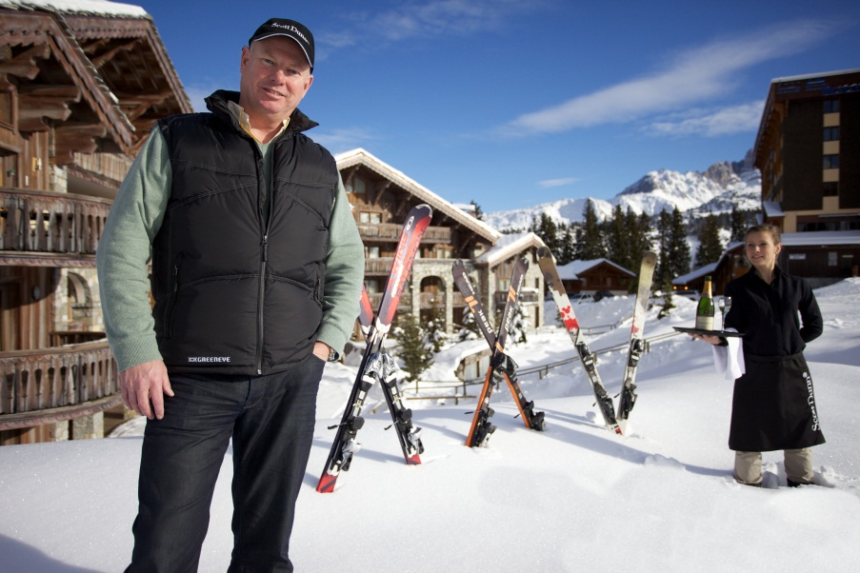
‘At Your Service’ Spotlight: Scott Dunn Travel
‘If you’re part of the DNA of the company, you understand the importance of the guest,’ Andrew Dunn.
British luxury travel company established a benchmark for Alpine chalet holidays
70% repeat business through loyalty and referral
Differentiated on opulence and personal, high quality service
Unexpected acts of kindness (U.A.K.s)
Undersells, over-delivers

Slide 3
Service quality
….customers’ perceptions of the service component of a product, and these perceptions are said to be based on five dimensions: reliability, assurance, empathy, responsiveness, and tangibles
Evaluation of purchase, determine satisfaction and likelihood of repurchase
Key factor in differentiating service products and building competitive advantage
Impacts profits and other financial outcomes of the organization

Slide 4
Relative importance of the service economy
Shift from manufacturing to a focus on customer service
Quality service increasingly critical to success
Services sector employment
45 % of the world’s total labor force
7 out of 10 people in global service industries
Share in total economic activity increasing over time
Western countries, accounts for over ¾ of GDP
Rising trend expected to continue
Reflects higher consumer and business demand,
Outsourcing of service-related activities
Information technology

Slide 5
Market share
Service quality key factor crucial
Differentiate service products
Win and retain customers
Build a competitive advantage
Customer satisfaction and loyalty
keys to long-term profitability,
‘Satisfying’ customers not enough
Delight customers to ensure long-term loyalty

Slide 6
Satisfaction measure

Slide 7
Prices and profit
Retaining 5 % of customers
Increase profits by 25% - 85 %
Higher-than-normal market share growth
Premium prices
~8 % higher price than competitors (Gale, 1992)
Customer satisfaction at macro levels
Predictive of consumer spending
GDP

Slide 8
Value of great service

Slide 9
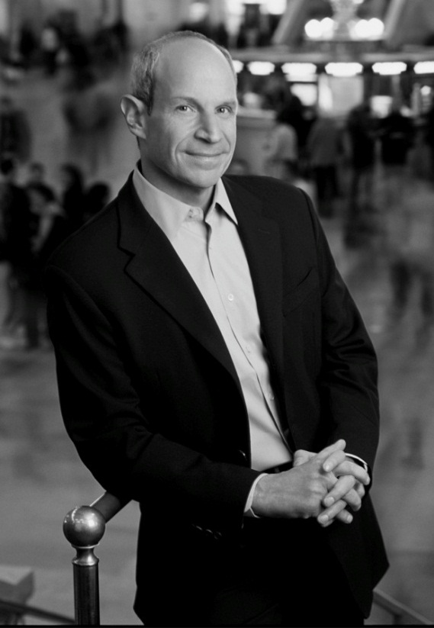
Snapshot: Jonathan Tisch, Loews Hotels & Resorts
‘The Power of We’ - success cannot be achieved individually
Professional philosophy
Building relationships with colleagues
Empowering employees
Collaborating with competitors
Customer outreach
Beyond advertising campaigns
“Buzz” and word-of-mouth marketing
Creates customer experiences
Good Neighbor Policy
Comprehensive outreach program
Links business with communities
Advocates social responsibility

Slide 10
The behavioral consequences of customer service
Positive behavioral intention indicators
Saying positive things
Recommending company or service
Paying a premium
Demonstrating loyalty
Negative behavioral intention
Complaining
Spending less money
Signaling poised to leave the company

Slide 11
Behavioral and financial consequences of service quality

Slide 12
The Apostle Model

Slide 13
The service profit chain
Employee satisfaction, loyalty
Internal service quality
Employee productivity
Customer satisfaction, loyalty
Value of services provided to the customer
Customer retention
Lifetime value of a customer
Financial value of long-term relationships
Potential lifetime revenue
Average lifespan
Sales of additional products and services
Referrals

Slide 14
The service profit chain

Slide 15
Offensive and defensive marketing
Offensive marketing
Attract more, better customers
Improve reputation
Higher market share
Price premiums
Defensive marketing
Retain existing customers
Longtime customer more profitable
Lower costs
Attracting a new customer five times more costly

Slide 16
Offensive and defensive marketing effects of service

Slide 17
Financial implications of poor customer service
Consumer spending trends correspond with customer satisfaction
Unhappy customers spend less
Frustrated customers may share unfavorable opinions
Social media, customer service terrorists
Business spending to replace customers
81 % of American, refuse to do business after poor service

Slide 18
Resolving customer complaints
Associated cost
52 % expect compensation, even if the problem is resolved
70 % seek apology, reimbursement
Consumers more forgiving if a company has earned trust over time
9/10 consumers willing to give a company a second chance
If they have experienced great customer service in the past
Reducing customer defections by 5 % can double profits

Slide 19
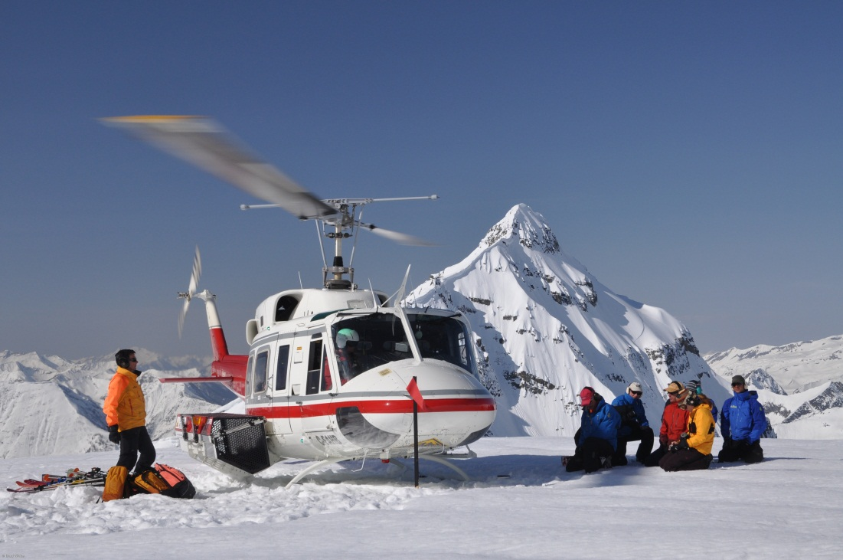
Case Study: Profiting from fun in the Canadian Rockies
CMH (Canadian Mountain Holidays) is just a bunch of mountain guides taking people into the mountains to have fun.
Unique marketing strategies
‘Word of mouth’
Search engine optimization, social media
‘An Evening with CMH’
CMH European agents
‘Adventure Collection’

