Slide 2
Topics Covered
Internal marketing
Establishment of a service culture
The importance of empowerment
Development of a marketing approach to human resource management
Dissemination of marketing information to employees
Implementation of a reward and recognition system

Slide 3
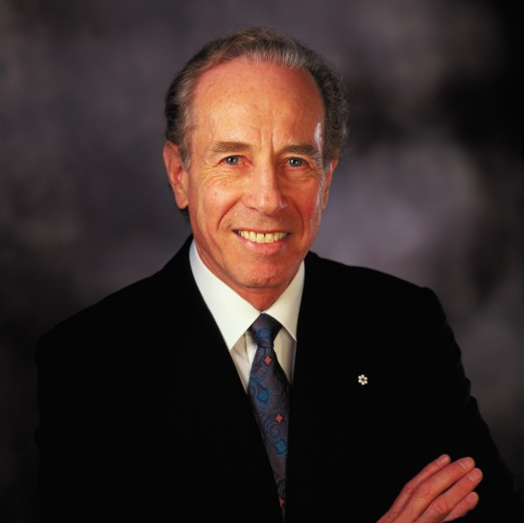
‘At Your Service’ Spotlight: Four Seasons Hotels and Resorts
The Golden Rule
Focus on managing mid-sized luxury hotels
Service more important than fixtures and fittings
Value-added extras
External quality control audits
300 operating standards
Strong internal service culture
Staff recruitment, perks, awards and internal promotion
Customer base
Repeat guests, willing to pay, recommend to friends
Recognition and Awards
Five Diamond Award, Fortune’s Hall of Fame,
Great Place to Work® Award, Robb Report ‘most exclusive brands of all time’

Slide 4
Internal marketing
…marketing aimed internally at a company’s own employees
Enables employees to deliver brand promise
Ensure consistently high service
Four-step process:
Establish a service culture
Develop a marketing approach to human resource management
Disseminate marketing information
Implement reward and recognition system
Too few organizations apply the concept
No unified concept
Corporate distraction (boost revenues, cut costs)

Slide 5
Link Between Internal Marketing and Profits
Figure 4.1

Slide 6
Organizational and marketing cultures
Organizational culture
Formal and informal guidelines, actually activities
Shared values and beliefs, behavioral norms
Individuals understanding of organizational functions
Marketing culture
Unwritten policies and guidelines and behavioral norms
Defines importance of marketing, manner of execution
Internal marketing an extension of a service culture
Service quality a dimension of marketing culture
Delivery and receipt of services

Slide 7
Service culture
….a culture that supports customer service through policies, procedures, reward systems, and actions
Culture must support customer service
Leaders crucial for transmitting, preserving culture
Commitment from management
positive attitude toward customers and employees
time and money transmitting value system
properly trained employees respond appropriately
empowered to do so by the organization
Establishing a service culture may have regional characteristics

Slide 8
The importance of empowerment
….the act of giving employees the authority to identify and solve guest problems or complaints on the spot, and to make improvements in the work processes when necessary
Impacts customer perceptions of service quality
Essential aspect of internal marketing
Involves decentralized decision-making
Demonstrated trust, respect for employees’ judgment
Gronroos’s interactive marketing concept
Empowered front-line employees
Control over task performance
Contingent on variability of customer needs, task complexity
Not suited to all employees

Slide 9
Empowerment and disempowerment: tourism and hospitality operations
Table 4.1 (Source: based on Lashley, 1995)

Slide 10
Marketing approach to human resource management
Attract and retain good employees
Creative approaches to attracting qualified employees
Understanding the employee market
Building a positive company image
Assist with employee motivation, incentives, training
Changing behaviors difficult, costly post-recruitment
Reduced ambiguity, improved service delivery
Link between training and customer service
Continuous training can improve morale, reduce turnover
Hospitality industry turnover double that of other industries

Slide 11
Developing employee pride
Motivates people to excel
More effective than money or position
Pride builders accomplish this by
Setting aspirations that touch emotions
Pursuing a meaningful purpose
Cultivating personal relationships of respect
Demonstrating high character
Injecting humor

Slide 12

Snapshot: Igniting the Spirit to Serve in Hong Kong
Passionately exceeding expectations.
Live Renaissance Values: Intriguing, Indigenous and Independent.
Training and recognition of ‘high guest contact personnel’
Advance planning and anticipating needs
Clues from guests ‘watch, listen and ACT’
Flexibility to react spontaneously, counteract problems
Guests made to feel special
Wow factors
Repeat customers pampered
Continuous Improvement
Inspiration from competitors
Newsletters e.g. ehotelier.com
Social Media monitoring
Mystery Shopping

Slide 13
Dissemination of marketing information to employees
Role and importance of employees
Implementation of strategies
Achievement of objectives
Frequency, quality, accuracy of communication
Moderates ambiguity
Increases job satisfaction
Communication mechanisms
One-to-one
Company meetings
Training sessions
Newsletters, emails, reports, videotapes
Blogs
Notes:
S

Slide 14
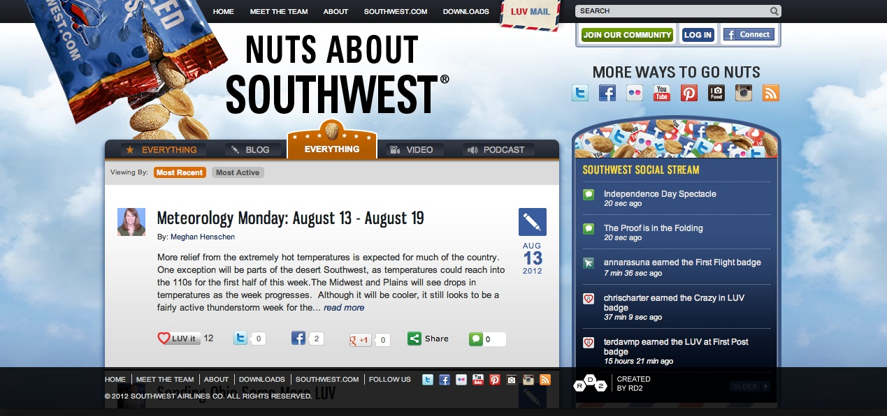
Southwest’s blog for customers and employees
Figure 4.2

Slide 15
Employee exclusion from the communication cycle
Manager, supervisor failure to convey information
Frontline employees should be informed of
Promotions and new products
Changes in the service delivery processes
Action steps in marketing plan
Poor internal communication a service quality risk
Customer-contact employees not able to deliver advertising promises

Slide 16
Implementation of reward and recognition systems
Employees should be made to feel happy and proud of their jobs
Canadian survey - being made to feel valued important motivator
Organizations should
Communicate performance objectives
Provide relevant training
Provide feedback
Provide recognition (non-cash rewards)
Tailor rewards to the interests of the employees
Employee dissatisfaction may lead to bad publicity

Slide 17
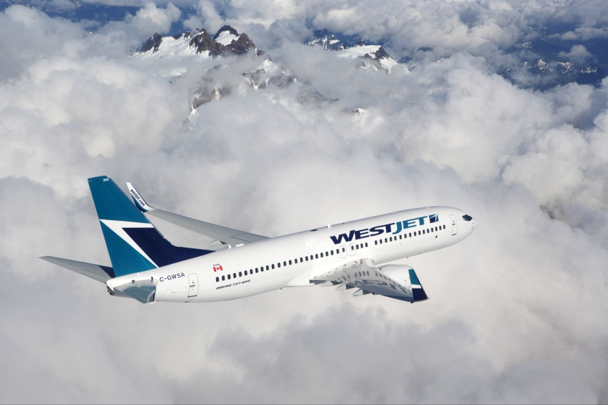
Case Study: WestJet Airlines: Fostering a caring culture
Canada’s Most Admired Corporate Culture
Pride in product intrinsic to WestJet’s success
Internal service as important as external service
Employee empowerment, spontaneity
4 Kudos program
CARE department –Create A Remarkable Experience
Sense of ownership, profit sharing

